Slide 1
Qualidade de Software: Testsmells Refatorados
Equipe:
Gabriel Cavalcanti Alves – 495439
André Silva Cavalcanti de Albuquerque – 378667
Abner Hakinnen Barbosa Bandeira de Lima - 427541

Slide 2
1 - Assertion Roulette (Add Assertion Explanation) 2 - Eager Test (Extract Method) 3 - Duplicate Assertion (Extract Method)
Entrega 1

Slide 3
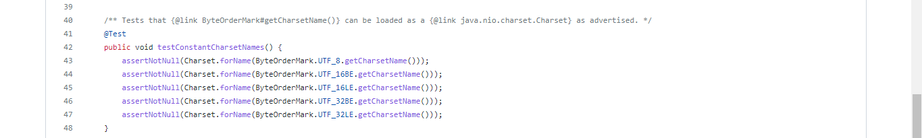
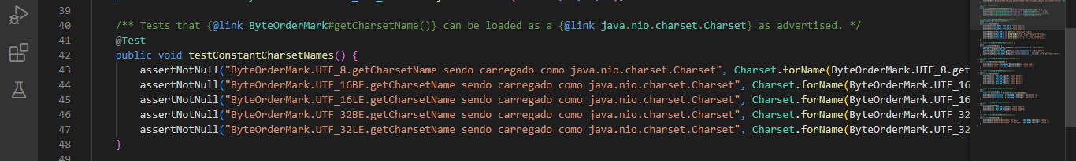
Assertion Roulette

Slide 4
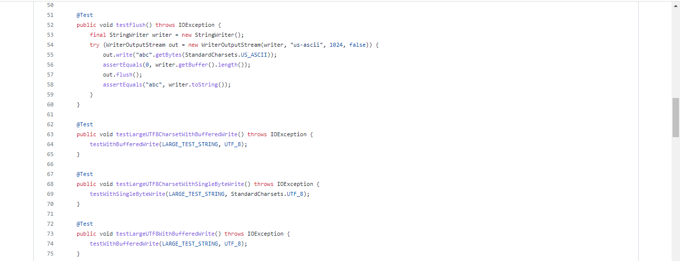
Eager Test

Slide 5
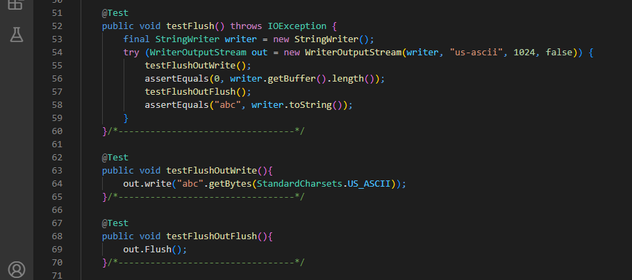

Slide 6
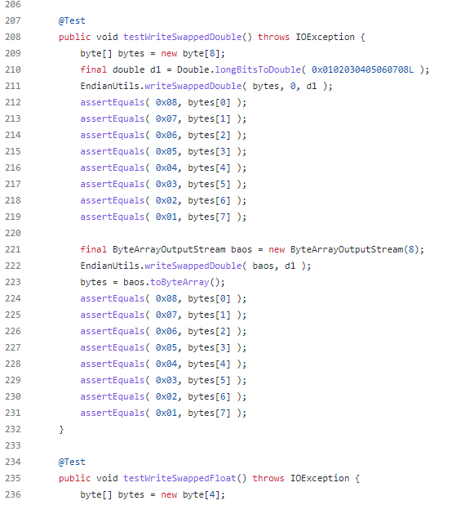
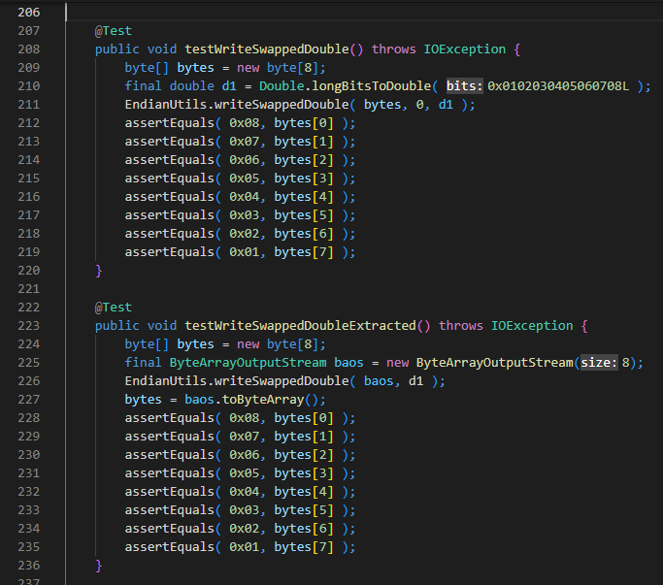
Duplicate Assertion

Slide 7
1 – Ignored Test 2 - Magic number Test (Replace Magic Number with Symbolic Constant) 3 - Lazy Test (Move Method)
Entrega 2

Slide 8
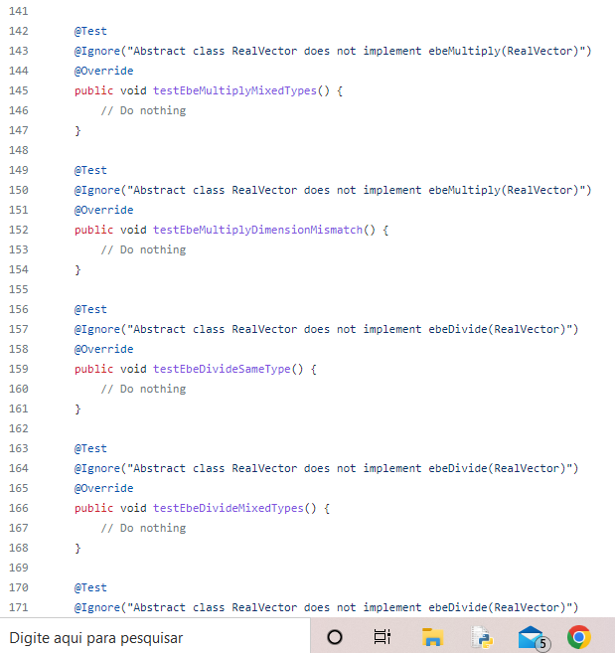
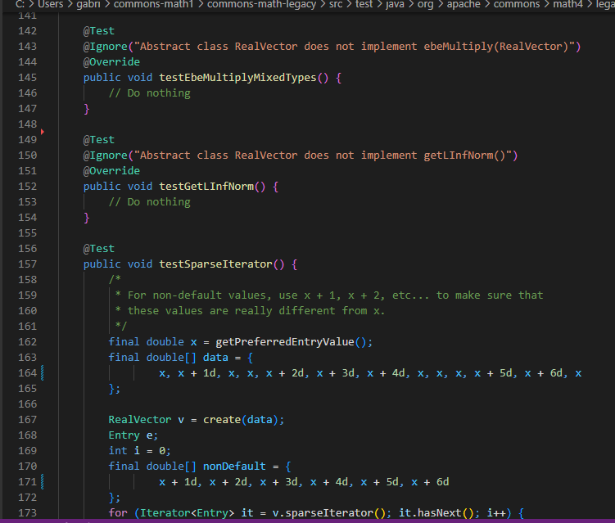
Ignored Test

Slide 9
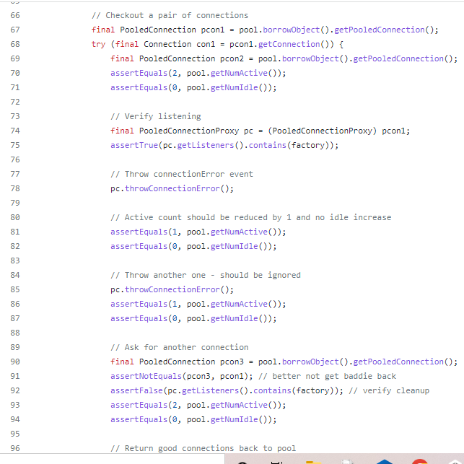
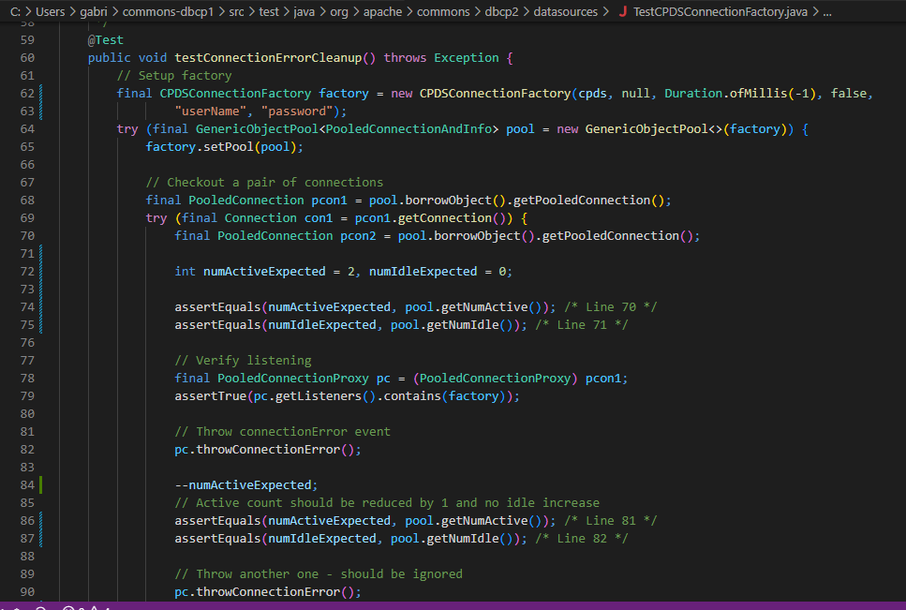
Magic Number Test

Slide 10
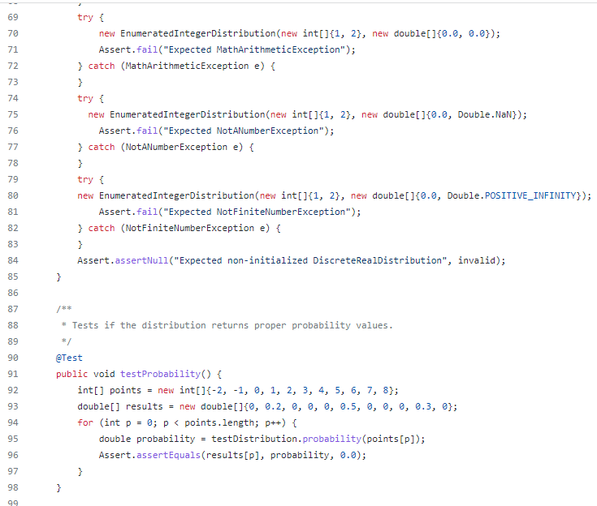
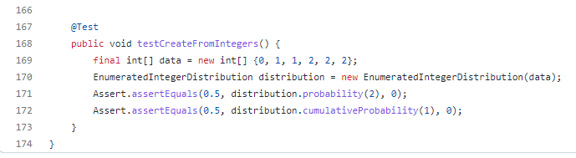
Lazy Test

Slide 11
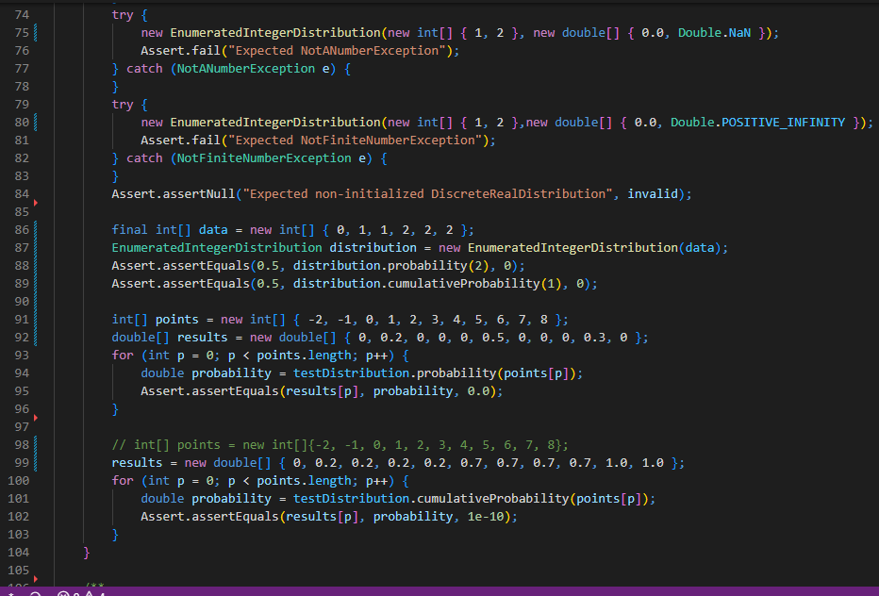

Slide 12
1 – Constructor IniTialization (SetUp External Resource) 2 – Print StatEment 3 – Unknown Test (Introduce Assertion)
Entrega 3

Slide 13
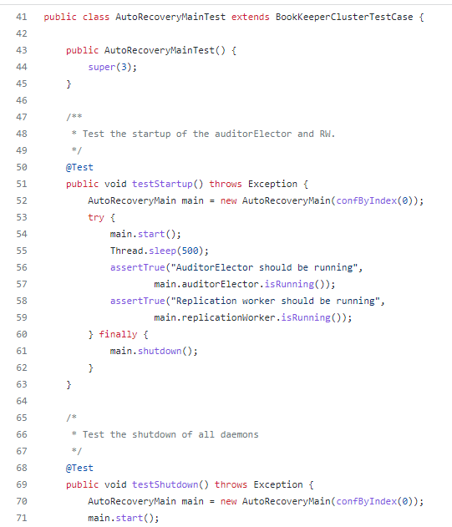
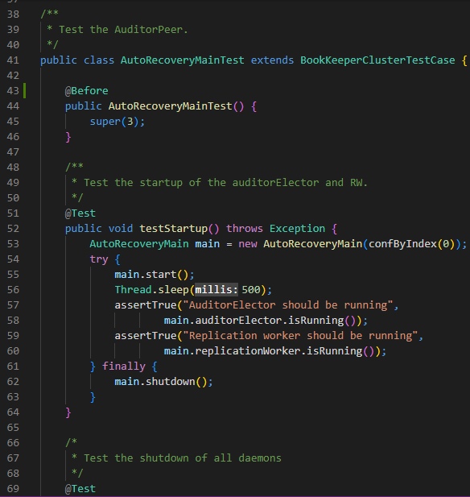
Constructor Inicialization

Slide 14
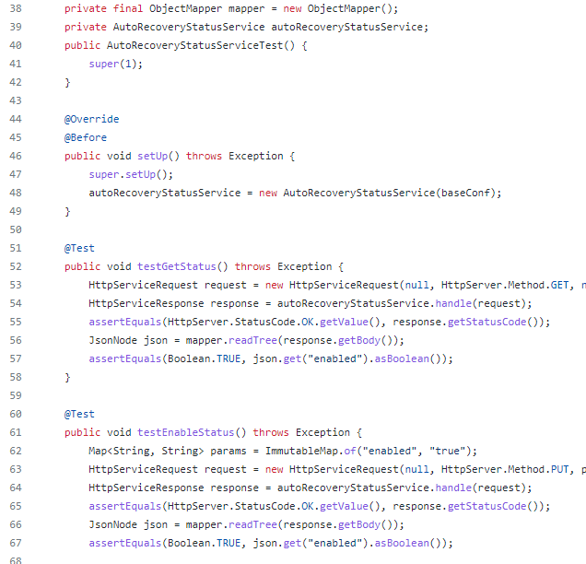
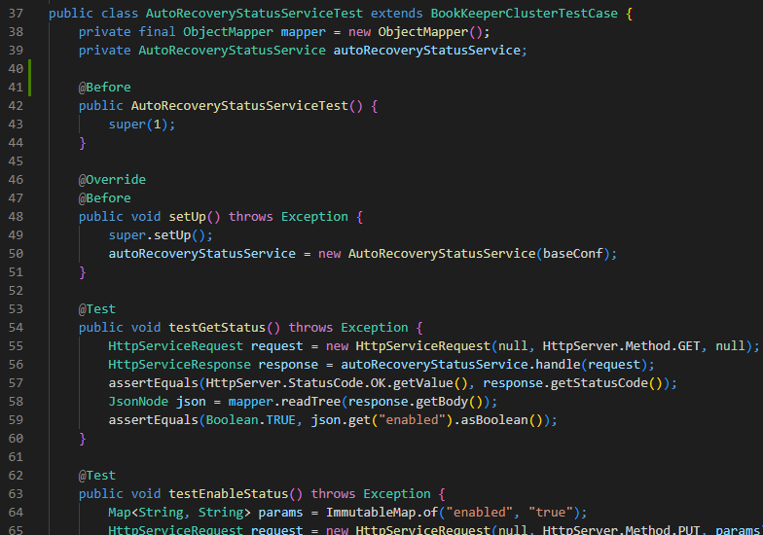

Slide 15
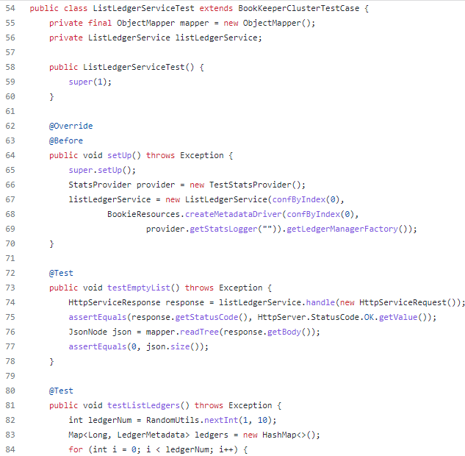
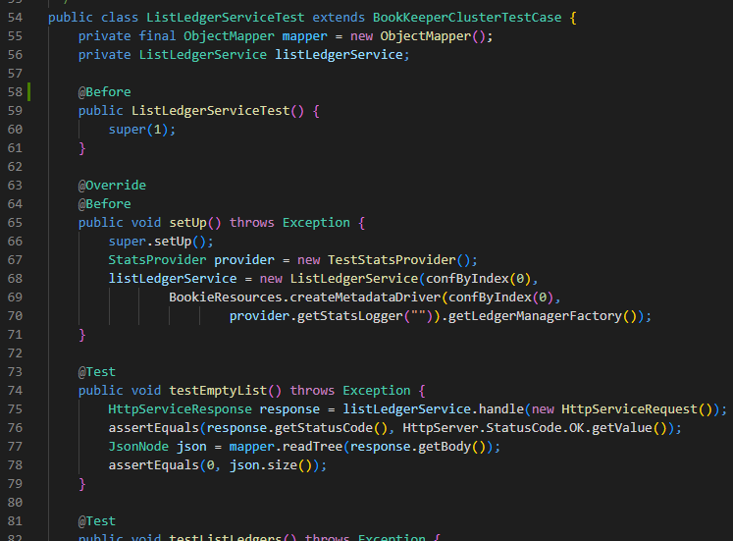

Slide 16
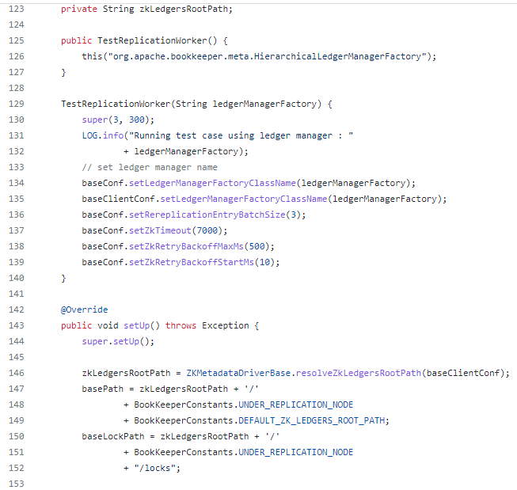
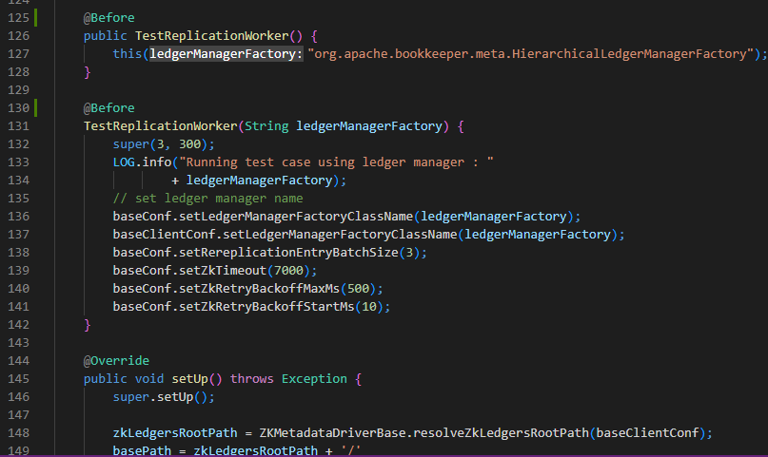

Slide 17
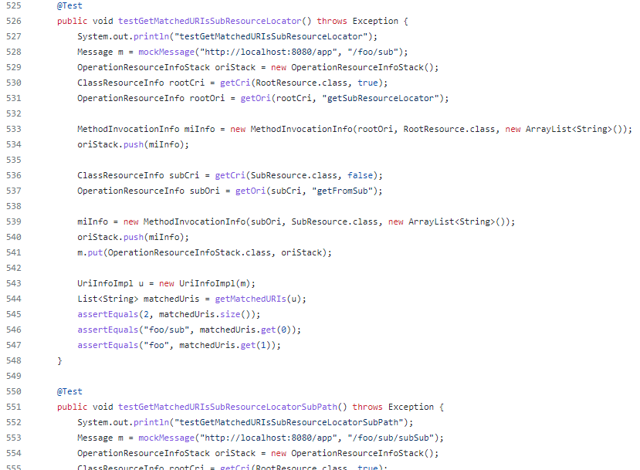
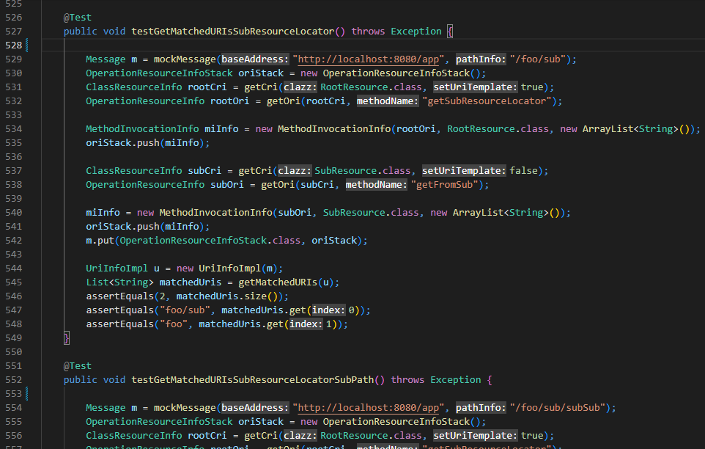
Print Statment

Slide 18
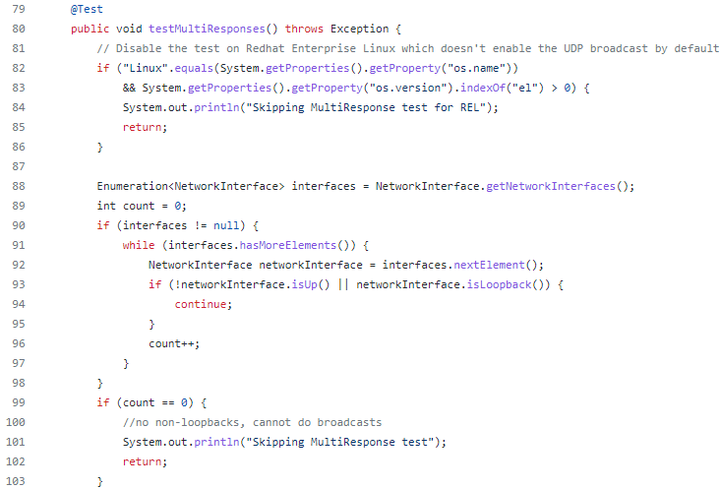
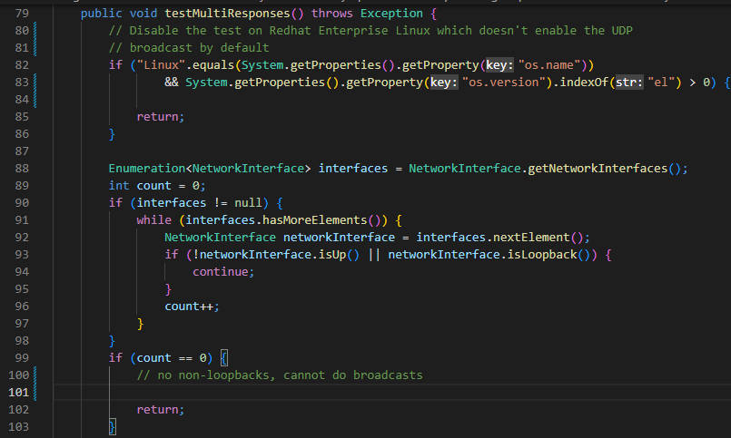

Slide 19
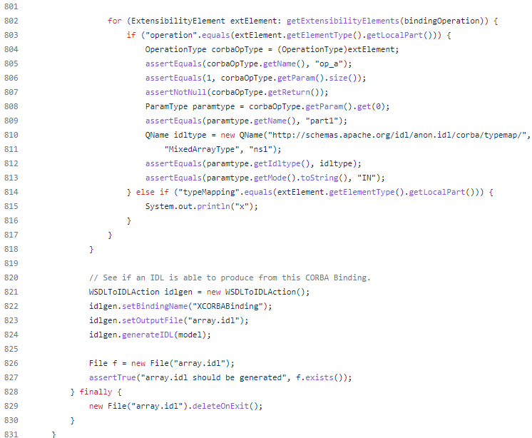
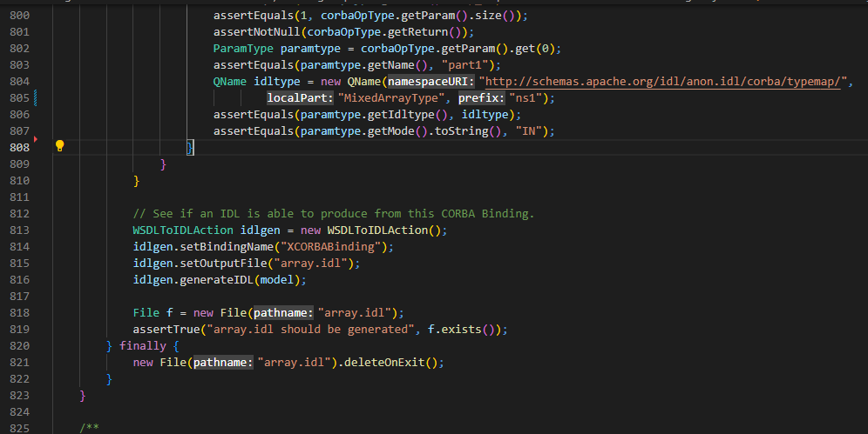

Slide 20
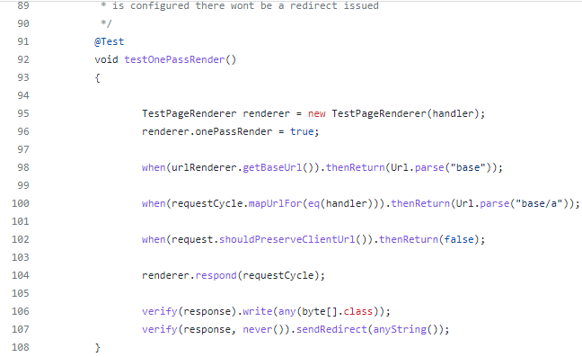
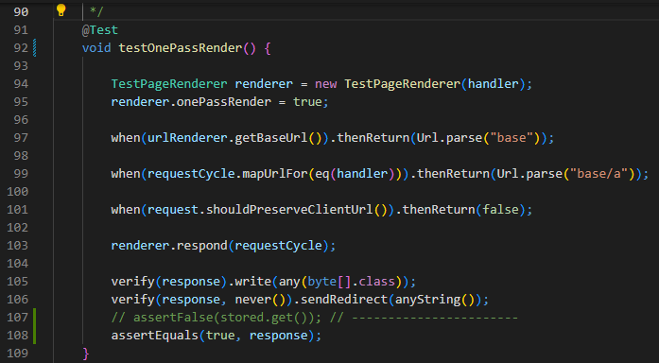
Unknown Test

Slide 21
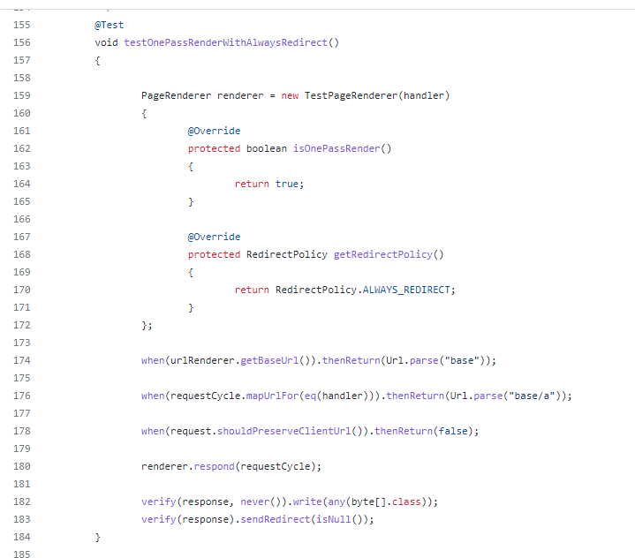
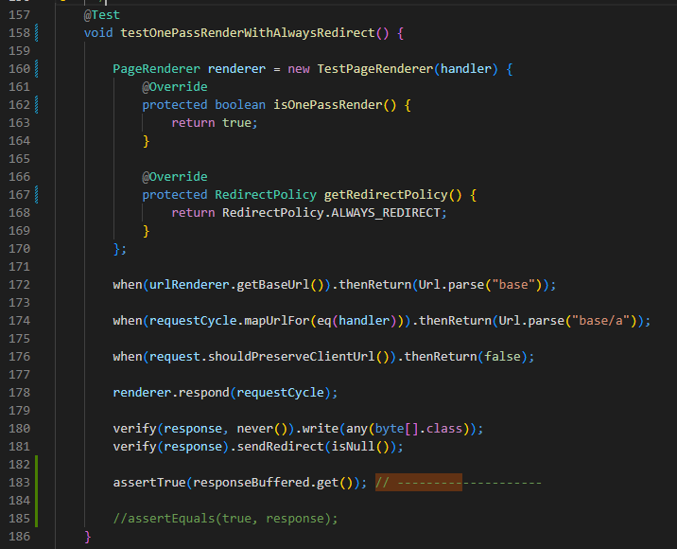

Slide 22
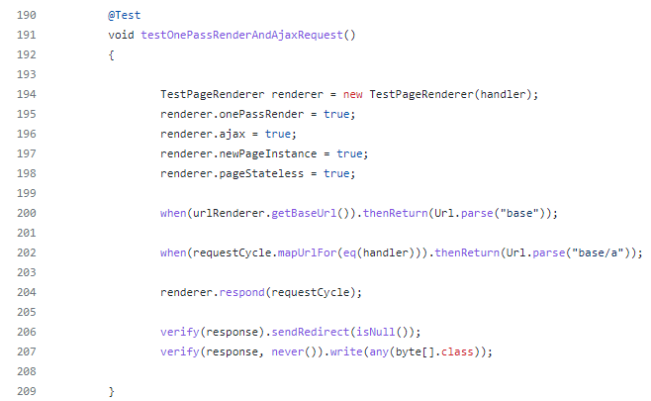
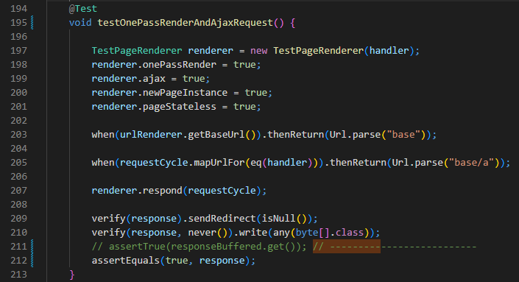

Slide 23
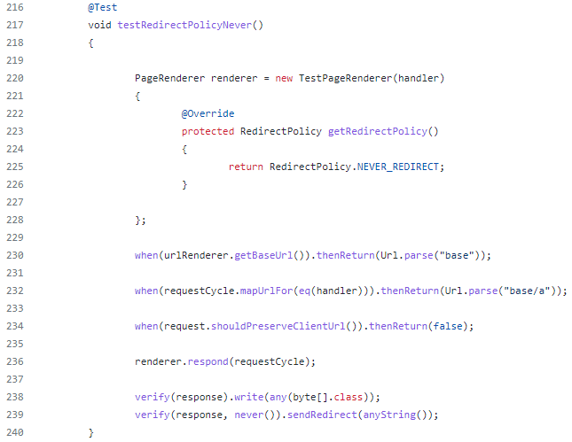
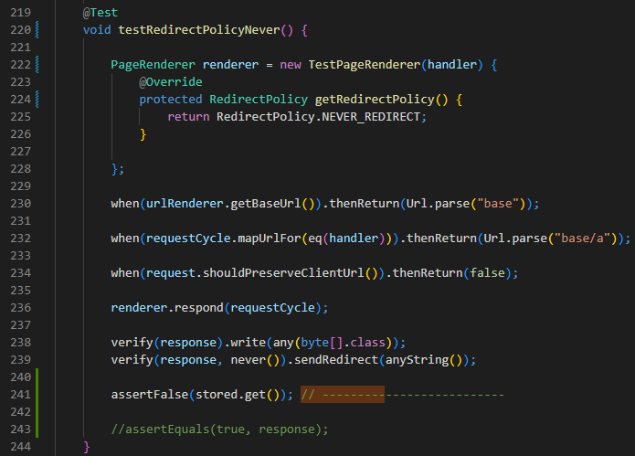

Slide 24
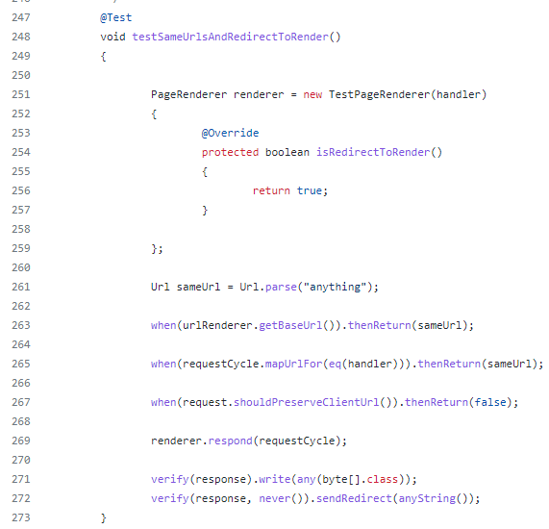
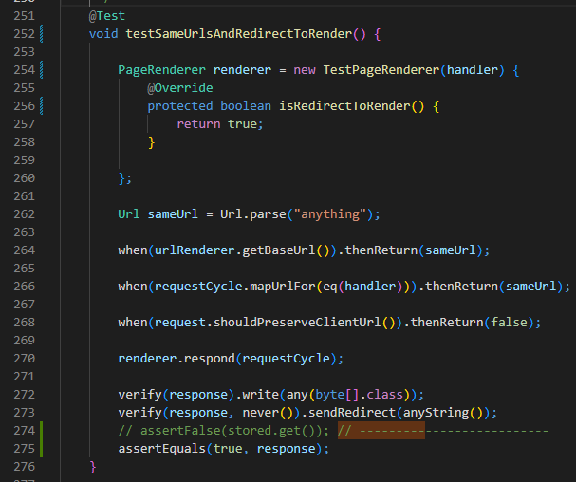

Slide 25
Bibliografia
Aulas
PDFs da disciplina
Conteúdo gravado
https://refactoring.guru/pt-br/refactoring/techniques
https://www.ramonsilva.net/post/t%C3%A9cnicas-comuns-de-refatora%C3%A7%C3%A3o
https://blog.geekhunter.com.br/refatoracao/
https://www.academia.edu/31982301/Refactoring_Test_Code
https://repositorio.ufba.br/bitstream/ri/33621/1/Dissertacao_RailanaSantana_VersaoFinal.pdf

